Slide 1

Joint Drum and Beat Detection
Seminar „Algorithms of Computer Music“
– Presentation by Lia Schulze Dephoff

Slide 2
Table of Content
Drum and beat detection
Drum transcription
Explanation of methods used in the paper
Experimental Setup
Datasets
Results
Example result tested on Greenday – „American Idiot“

Slide 3
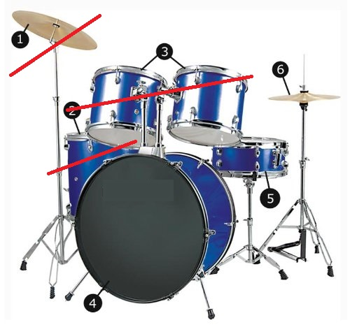
Drum and beat detection
Drum Detection:
  Focus on Kick-Drum, Snare, Hi-Hat
  Which?
Beat Detection:
  When?

Slide 4
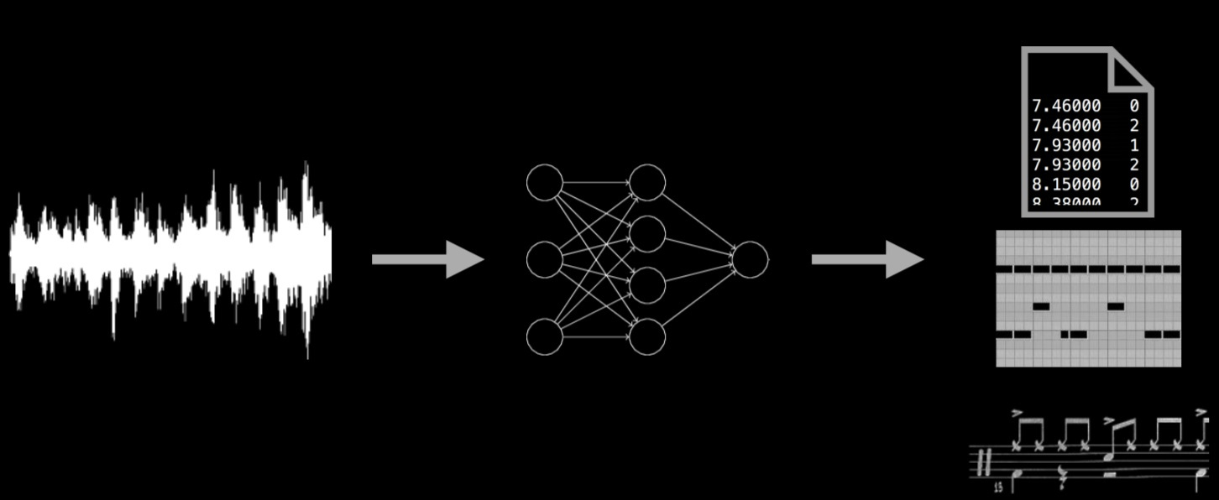
Drum Transcription

Slide 5
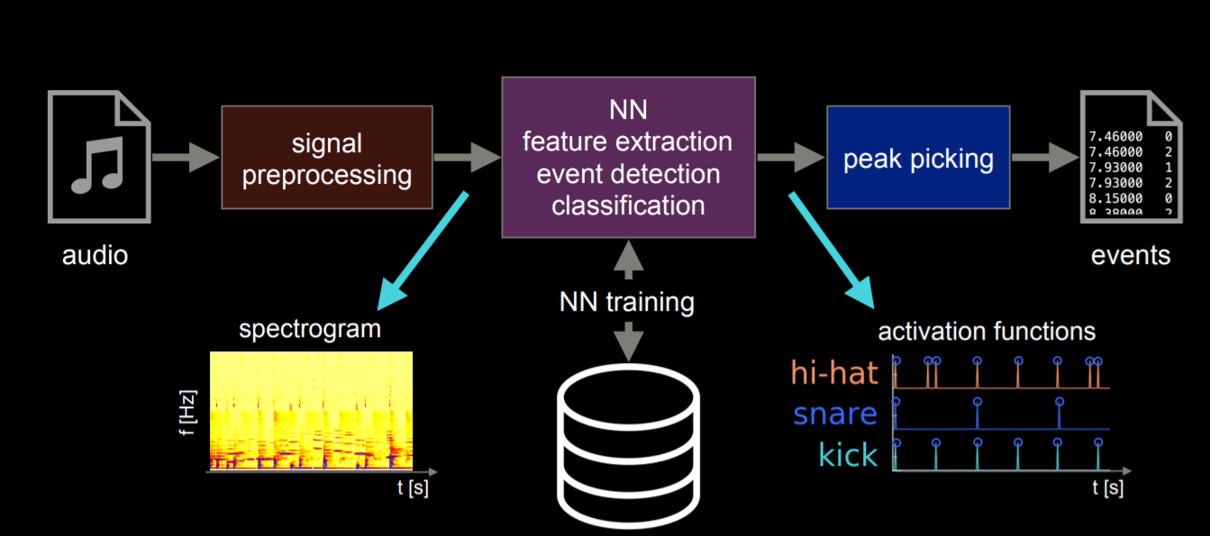
Methods

Slide 6
Recurrent Neural Networks
Small model
2 layers of 50 nodes
100 frames
Large model
3 layers of 30 nodes
400 frames
Wellsuited for:
drum and beat detection
Learning long term dependencies

Slide 7
Convolutional Neural Networks
Small model
9 frames
Large model
25 frames
Best performing for image processing
Used for spectograms in the past
Max pooling
Batch normalization
Notes:
Learning rate initally 0.001

Slide 8
Convolutional Bidirectional Recurrent Neural Networks
Small model
2 recurrent layers
50 nodes
9 frames
Large model
3 recurrent layers
60 nodes
13 frames
Convolutional Layers for input --> Acoustic modeling
Recurrent Layers for structural pattern --> learn temporal structure

Slide 9
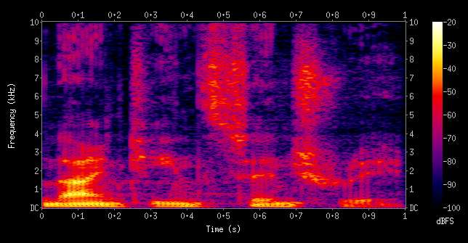
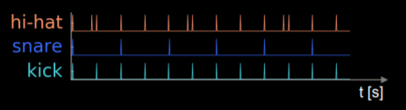
Experimental Setup
Drum Detection (DT)
  Spectogram as input
  Drum target function as output
Notes:
Feature vectors for each drum and beat: signal 1 if present 0 if not

Slide 10

Experimental Setup
Drum Detection with Oracle Beat Features (BF)
  Spectogram and beats as input
  Drum target function as output
Notes:
Feature vectors for each drum and beat: signal 1 if present 0 if not

Slide 11
Experimental Setup
Joint Drum and Beat Detection (MT)
  Spectogram as input
  Drum and beat target function as output
Notes:
Feature vectors for each drum and beat: signal 1 if present 0 if not
MT = Multi-Task

Slide 12
Datasets
IDMT-SMT-Drums
  Recorded acoustic drum
  Drum synthesizer
  Drum sample libraries
  Solo drum + solo instrument
ENST-Drums
  Recorded acoustic drum
  Accompaniment tracks
RBMA13_Drums
  Variety of electronically produced music
  With other instruments and singing voices
Notes:
Different drummer , different drumsets
RBMA13 – Red Bull Music Academy

Slide 13
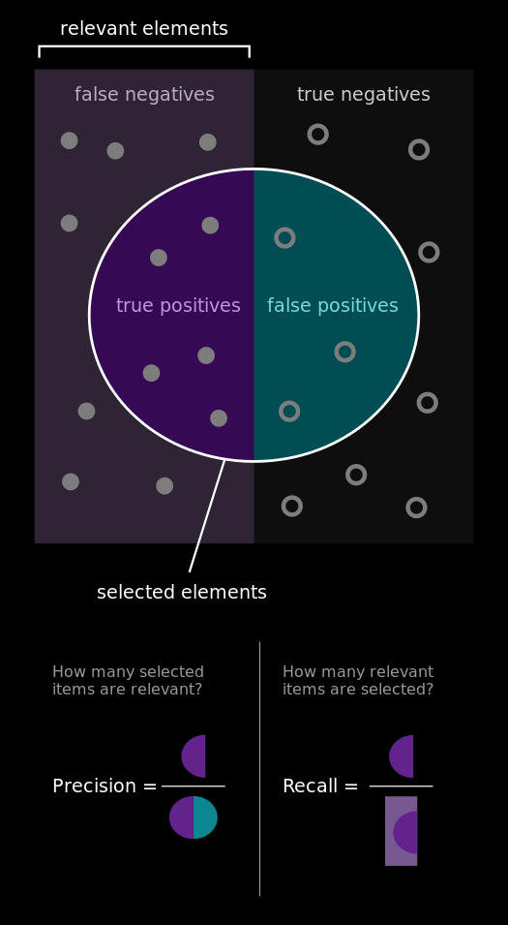
Results
F-measure (harmonic mean over precision and recall)
20ms tolerance window

Slide 14
Results on SMT and ENST

Slide 15
Results on RBMA13

Slide 16
Test system on songs
Example Greenday – American Idiot

Slide 17
Conclusion
BCRNNs can outperform state of the art and RNNs
Beats and Downbeats are beneficial for for drum detection
Multi-task learning is beneficial
Some more optimizations could lead to better results

Slide 18
Sources
https://www.amazon.de/Schlagzeug-Drumset-9-teilig-Hi-Hat-Trommel/dp/B0031RESY8
http://www.ifs.tuwien.ac.at/~vogl/slides/ismir-17.pdf
http://colah.github.io/posts/2015-08-Understanding-LSTMs/
https://leonardoaraujosantos.gitbooks.io/artificial-inteligence/content/dropout_layer.html
http://neuralnetworksanddeeplearning.com/chap1.html
https://en.wikipedia.org/wiki/Spectrogram
https://en.wikipedia.org/wiki/Precision_and_recall

Slide 19
Thank you!

Slide 20

Neural Networks

Slide 21
Pooling Layer
Non-linear down-sampling
E.g. Max-Pooling:
  Use maximum value from each cluster of neurons at prior layer
  reduce number of parameters and computation time
1 | 3 | 5 | 8
0 | 5 | 4 | 6
2 | 7 | 9 | 0
1 | 6 | 4 | 4
5 | 8
7 | 9
Notes:
Average pooling, …

Slide 22
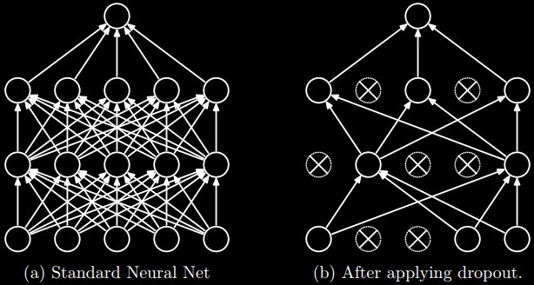
Dropout Layer
During training
Deactivate neurons per layer
→ improve generalization

Slide 23
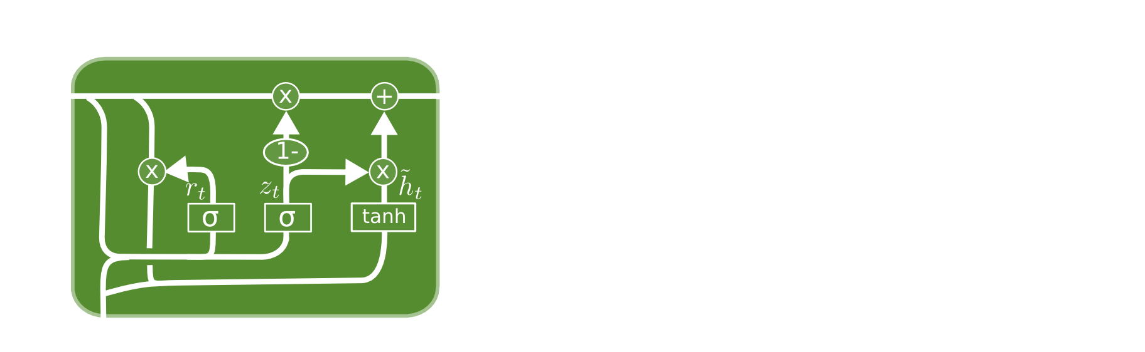
Recurennt Neural Networks
GRU (Gated Recurrent Unit)
Learning rate initially 0.007

Slide 24
Convolutional Neural Networks
32 3x3 filters
32 3x3 filters
3x3 max pool layer
Drop-out layer
64 3x3 filters
64 3x3 filters
3x3 max pool layer
Drop-out layer
Notes:
Learning rate initally 0.001

Slide 25
Feature Extraction
Calculate logarithmic magnitude spectogram
Frequency bins transformed to logarithmic scale
Positive-first-order differential overtime is calculated and concatenated
--> results in feature vectors

Slide 26
Activation Function Calculation
Train all different NNs with same input features
Output layers 3 or 5 sigmoid units (HH, BD, SD, Beat, Downbeat)
Train (2/3), validate (15% of training data), evaluate(1/3)
No improvement for 10 epochs --> Reducing learning rate
Notes:
15% of training data is seperated from training set

